Slide 1
Githunt
A one step solution to finding the right Github profile
Group 11

Slide 2


GitHunt: Search Made Simple
GitHunt is designed to address the challenges recruiters face in finding the right candidates swiftly. We understand the critical role talent plays in driving success, and that's why we've created a platform that offers real-time updates without the hassle of repeated refreshes.

Slide 3


Need for the website
Traditional candidate search methods often result in outdated information and inefficient processes. Constant page refreshes can lead to frustration and delays in accessing updated candidate profiles. GitHunt aims to solve these challenges by providing instant results and a seamless user experience

Slide 4

The website
GitHunt: Embracing the single page application
We achieve this through the use of cutting-edge APIs for real-time candidate search. GitHunt offers free access and unlimited searches for all users, ensuring accessibility and convenience.
By embracing the single-page application concept, we eliminate the need for page reloads, providing a fluid browsing experience.

Slide 5

What is githunt
These are third-party apps available that provide functionality to typically allow users to view GitHub profiles, explore repositories, track activity, and more. Some of them might have different names or offer additional features beyond just profile viewing.
These third-party apps are often developed by independent developers or companies leveraging GitHub's API to access user data and build additional tools or services around GitHub. They may be available for various platforms such as web, desktop, or mobile.

Slide 6
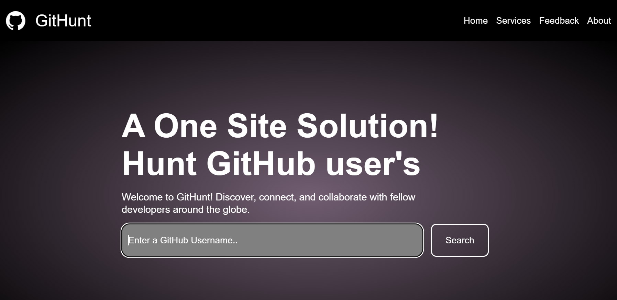
Our Project Landing Page

Slide 7
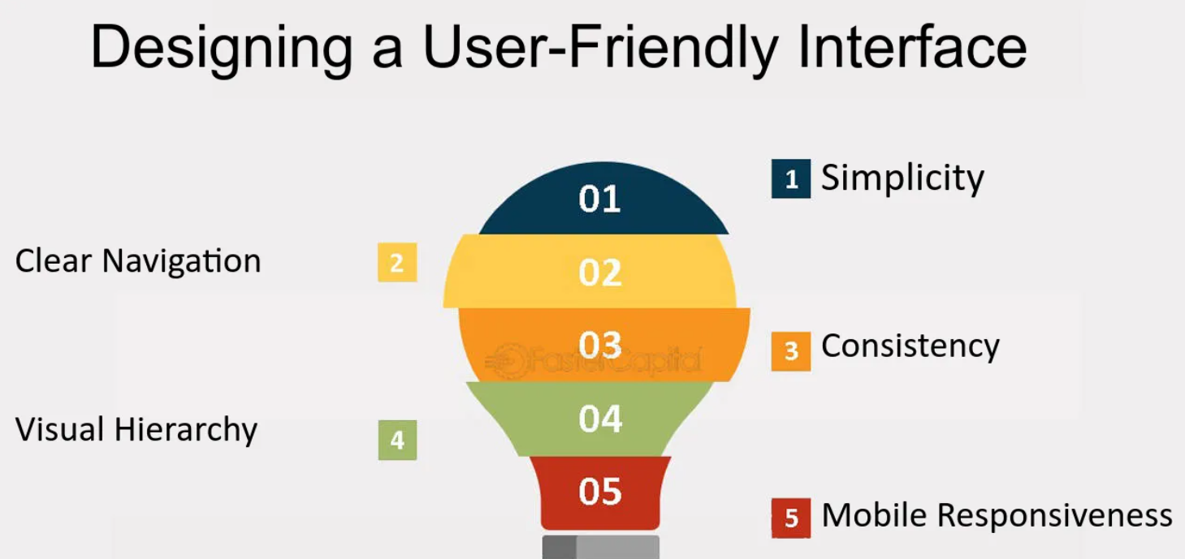

Slide 8
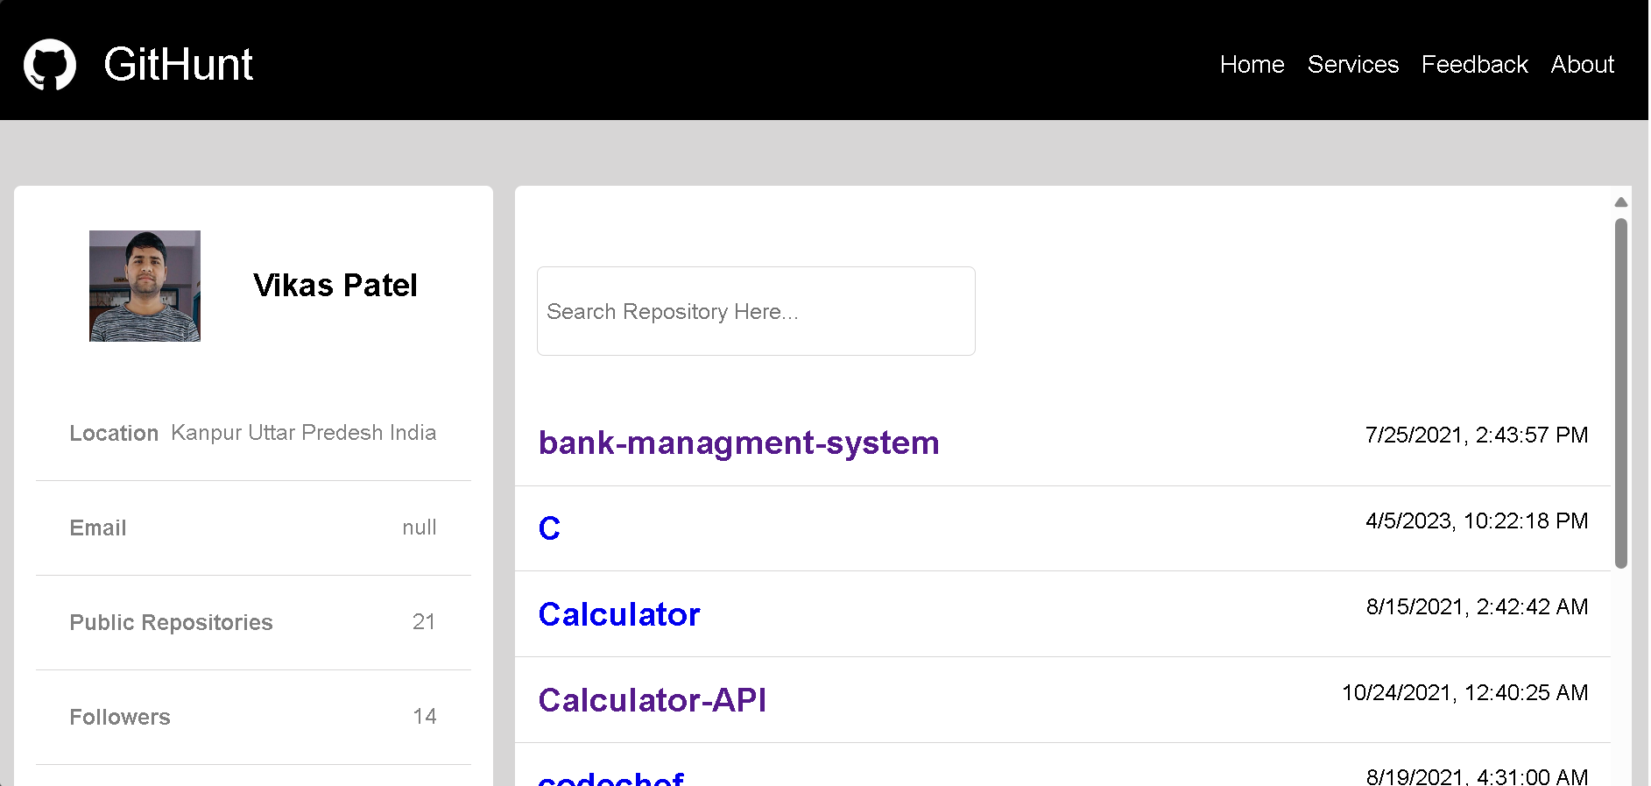

Slide 9
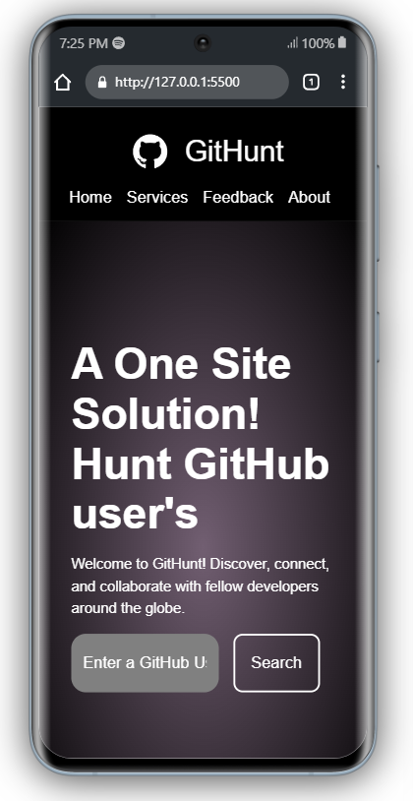
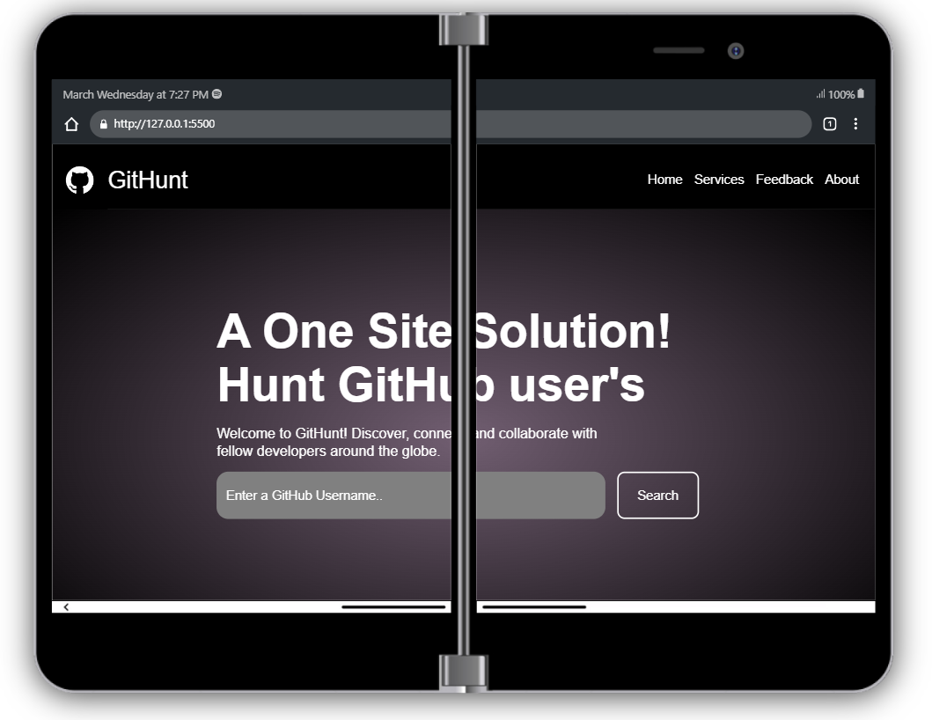
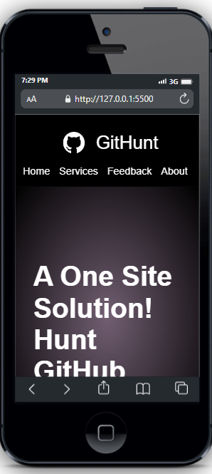
From Desktop to mobile
GitHunt is designed to be responsive across various devices, allowing users to access the platform seamlessly. Whether you're using it on a desktop, laptop, tablet, or mobile device, GitHunt adapts to your needs, ensuring a consistent experience."

Slide 10

Uses of the software
This software is an easier way to see the overview of any github username that we want to search.
We have added an alert for the username to be shown when we search it and also, we have added an error condition that shows us in red that the username does not exist if that is the case.

Slide 11

How Our Model Is Better Than Others
Our single-page application : The concept sets us apart from traditional candidate search platforms. Unlike platforms that require constant page reloads, GitHunt offers seamless user interaction and real-time updates. But don't just take my word for it—our users rave about the efficiency and convenience GitHunt brings to their recruitment process.

Slide 12

Html used in the project
We have used the header tag for the top of the page and given the class logo to the background image that we have used in the project. It is a collection of images which changes every them we reload the website.
We have made the class hero for the search area where we input the github username and made the input box and a button with class submit which we also added in javascript as eventlistener.

Slide 13

Css used in the project
We have used the css for every class name that we have used individually as well as the error message colour.
To add responsiveness, we have also added the case for width<=768px.

Slide 14

Javascript used in the project
We have used API in this project so the javascript mainly focuses on that. Other than that we have used the preventDefault method to use the content of search box for out API.
Then we fetched the details of the user by
fetch(`https://api.github.com/users/${search}/repos`). This code basically uses our input to search the user.
To show the userdata in a presentable format, we have used the values that we took from the API and put them in a presentable format by giving them classes and then adding css to those classes.

Slide 15

Handled the issue
For exception handling, we have used the .catch((error) => {
document.querySelector("#section").innerHTML =
'<div class = "error"> Username does not exist </div>';
});
This code executes if there is an error (i.e the api does not contain the user that we have searched.) and shows that the username does not exist.

Slide 16

Future Scope
As we look to the future, GitHunt has exciting enhancements in store. We're exploring deeper integration with GitHub accounts, including features such as user actions (like liking and following) that will reflect on GitHub profiles. These enhancements will further streamline the recruitment process and enhance user engagement

Slide 17

Greetings
Name | Roll Number
Krishna Singh | 2210990521
Lakshay Kumar | 2210990536
Pardume Sharma | 2210990638
Aryan | 210990174

